Slide 1
Team 3’s Operating System
Aaron Chan, Will Bicks, Nick Merante, John Arrandale

Slide 2
Project Overview
Four projects
Networking Stack
Support communicating with other computers over a network
VGA Graphics Mode
Modular VGA driver for 256-color graphics with drawing and timing primitives
Audio Interface
Add a driver for the Intel High Definition Audio specification to generate and output audio
DMX512 Support
Add a driver supporting the DMX512 protocol to control stage and architectural lighting

Slide 3

Networking Stack

Slide 4
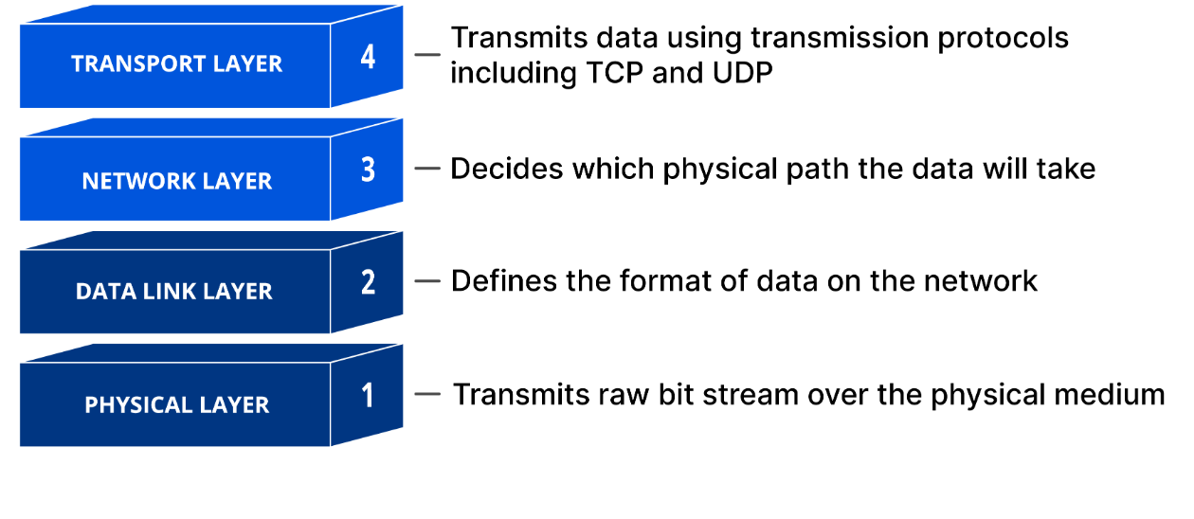
Network Stack Support
Design philosophies
Platform independence
Testability
Modularity
Implement driver support for an Ethernet chip
Implements protocols from layers 2-4
RFCs used as reference

Slide 5
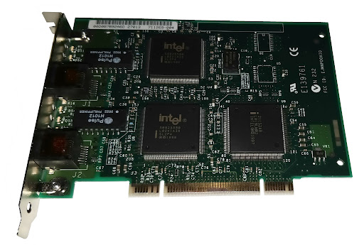
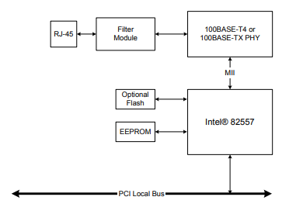
Physical Layer: Intel 8255x
DSL Machines equipped with both an Intel 8255X and Intel I219-V Ethernet controller
Chose the Intel 8255X for simplicity and better references
No socket offloading
OS required to provide physically contiguous buffers
Remaining network stack must be written in software
MAC stored in EEPROM
Requires interfacing with Ethernet II software module
QEMU offers simulation support (eepro100)
Platform independence maintained by having function pointers for interfacing over PCI
Allowed for testing in xv6 while baseline OS was having issues

Slide 6
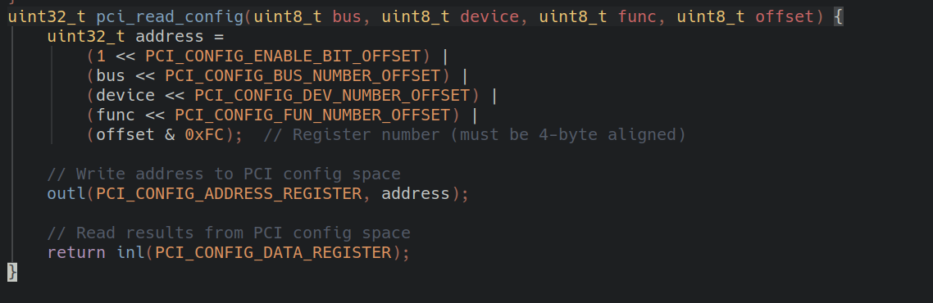
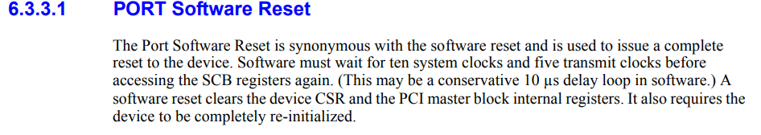
Physical Layer: Intel 8255x
Brute-force detect the device over the PCI bus
Searching for a device with vendor ID 0x8086 and device ID 0x1229
0xCF8 for accessing the PCI Config Address Register
0xCFC for accessing the PCI Data Register
Issue a port reset command
Grab BAR0, for doing MMIO access
Read EEPROM for MAC address
Needed for initializing Ethernet II in software later…
Allocate buffers and setup interrupts

Slide 7
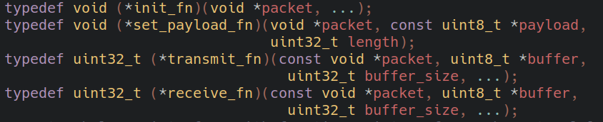
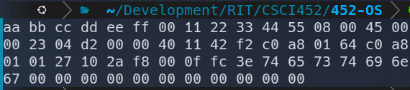
Link, Network and Transport Layers
Most protocols easy to implement in software
Reference RFC for the specification for each protocol
Ethernet II: RFC 894
IPv4: RFC 791
UDP: RFC 768
ARP: RFC 826
Function pointers for implementing general functionality
Initialization
Payload Set
Packet Send/Serialize
Packet Receive/Deserialize

Slide 8
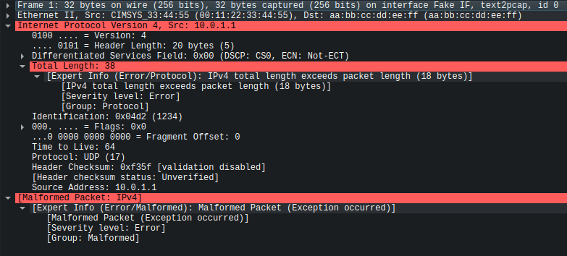
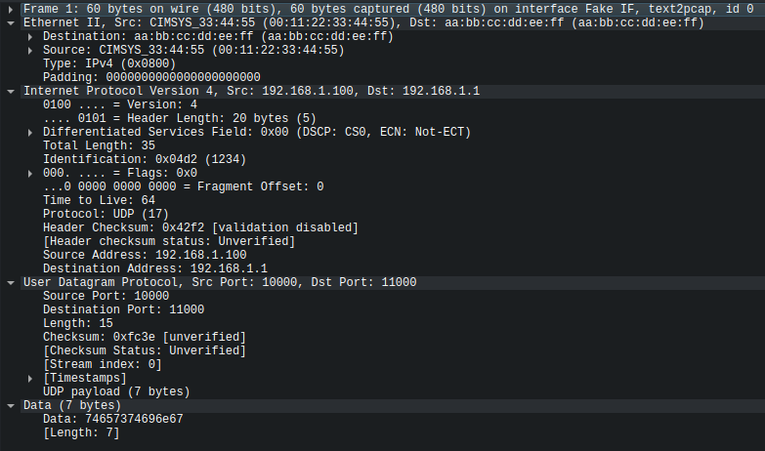
Network Stack Testing
Layers 2-4 tested using Wireshark
Build a test program that glues together the different protocols
Ethernet II - IPv4 - UDP
Print out the resulting buffer, do a text2pcap and run it through Wireshark

Slide 9
Integration
Define platform-specific register access functions for the driver to use
Initialize the 8255X and rest of the networking stack on startup
Issue a PORT RESET command
Read MAC address and initialize Ethernet II software module
Allocate buffers for Tx/Rx
Setup interrupts
Interrupts triggered when the wire receives something
Read data from the buffer it points to
Once data is processed, recycle the buffer by clearing the status and making it available again
System calls for sending and receiving packets
User applications can see what was received and send packets over a network

Slide 10
Challenges
Interfacing with the Intel 8255X
Struggled to perform a few operations like getting the device initialized
No control over whether the NIC has to be interfaced with through I/O or MMIO
Bit 0 of PCI BAR indicates how the device should be interfaced with
The datasheet is ~200 pages long…
Maintaining platform independence
Needed to see the network packet buffer easily during testing (i.e. printf calls)
Functions like memcpy where heavily used throughout the stack
Had to deal with compiling network stack like it was a normal C program and have it compile with the OS

Slide 11


VGA Graphics-Mode Driver
Nicholas Merante

Slide 12
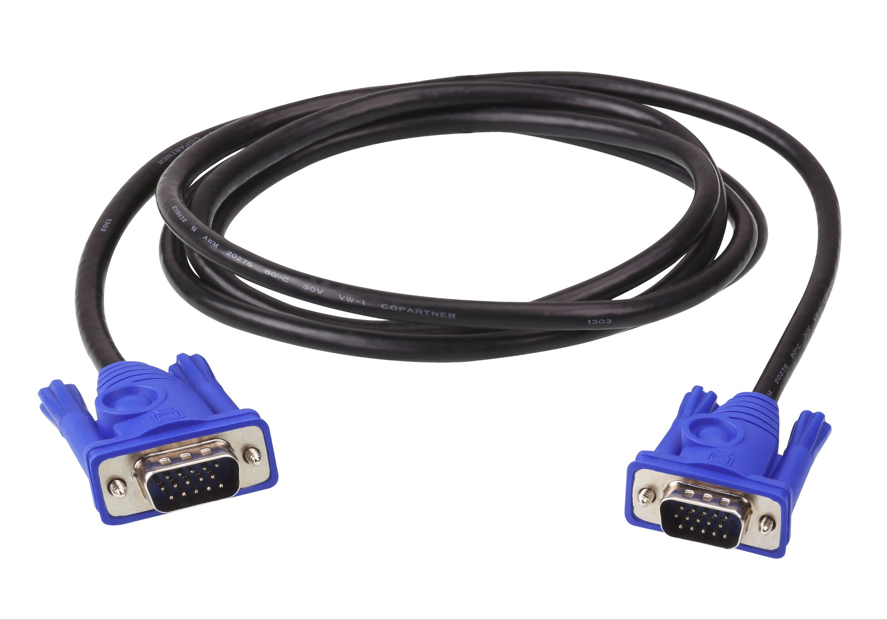
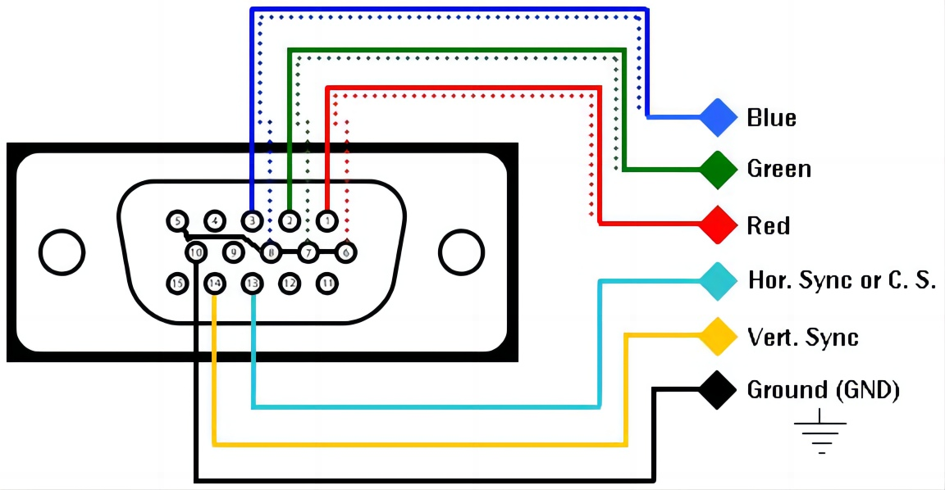
Driver Overview
Implement VGA Mode 13h graphics driver for 320×200, 256 colors
Provide primitives: pixels, lines, rectangles, circles, sprites
Add double-buffering, palette control, vsync
Demo applications: drawing tests, sprite demo, Snake game
DE-15 Connector

Slide 13
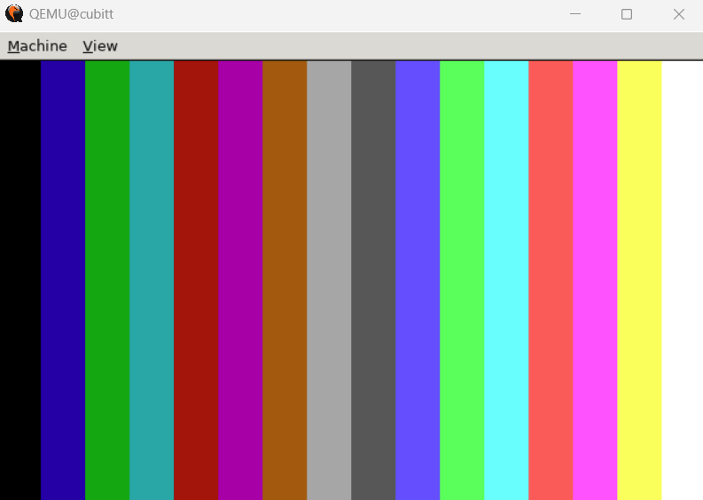
Hardware & Registers
Frame Buffer (Mode 13h)
Physical address: 0xA0000–0xAFFFF (64 KiB)
Each byte = one pixel’s 8-bit palette index
Vertical-Retrace Status
Port 0x3DA – Input Status Register 1
Bit 3 = 1 during VBlank → use in vga_wait_vsync() to avoid tearing
Mode Setting
BIOS INT 10h AH=0x00, AL=0x13 sets up CRTC and Sequencer registers (0x3C0–0x3DF) for 320×200×256 mode
Happens in boot.S before protected mode

Slide 14
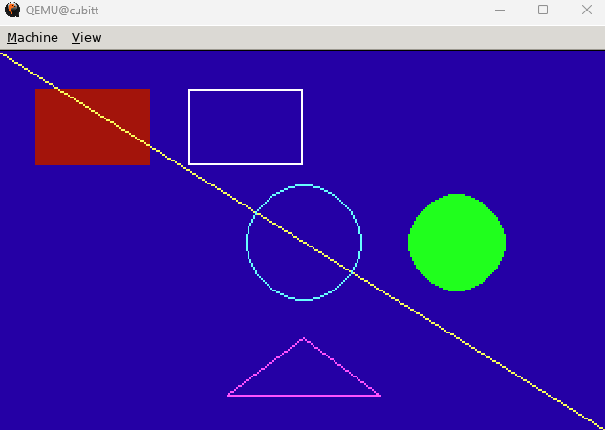
Design Philosophy
Keep API simple and modular
Separate buffer vs. direct VRAM access
Primitive functions write directly to VRAM, e.g. for shapes demo here →
Buffered function calls for animated visuals
Use Bresenham and Midpoint algorithms for efficiency

Slide 15
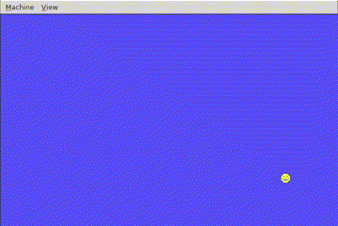
Sprite/Buffer Demo
Drawing primitives test
Sprite blitter test
Double buffer test
Backbuffer is written to as data updates
Once VSYNC is resetting for a new frame, entire backbuffer is dumped to VRAM
Reduce flickering

Slide 16
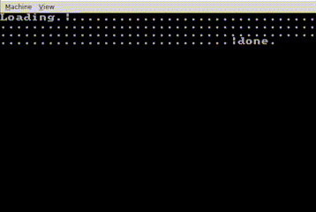
Text Console Demo
Basic character typing console
Not as complete as text-mode one in cio.c, but a good starting point
Proof of concept that basic font can be loaded in using the driver
For now, all calls to write to console (normally text-mode VGA) are redirected to serial

Slide 17
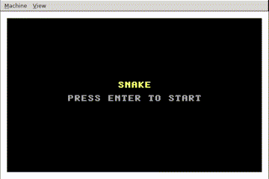
Conclusion
Snake game showcasing full driver
Modular VGA driver for 256-color graphics
Robust drawing and timing primitives
Extensible for future games and demos

Slide 18
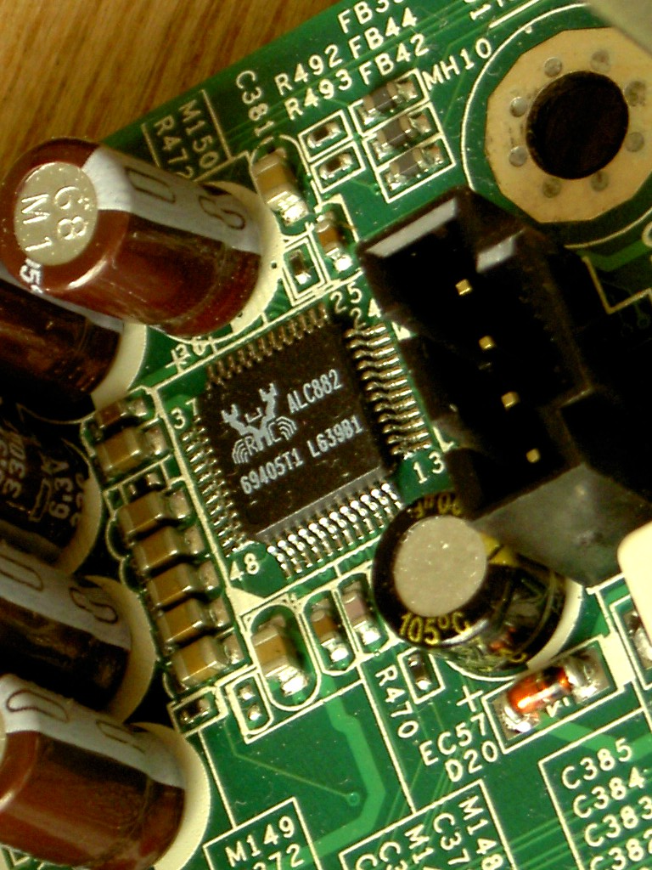
Audio Interface Driver
Will Bicks

Slide 19
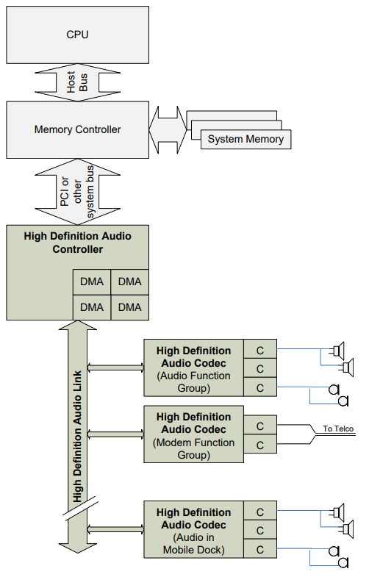
Intel High Definition Audio
Standard API implemented by multiple controller / code manufacturers.
Major components:
Controller: PCI device that commands audio streams, access host audio data via DMAs data, transfers with codecs via HD Audio Link
HD Audio Link: connects controller to one or more codec
Codec: Converts HD Audio Link to / from standard audio interfaces (e.g. consumer line level, TOSLINK, built in speaker).
Courtesy of Intel High Definition Audio Specification

Slide 20
HD Audio Initialization Process
Communication via ring buffers (host to controller commands, controller to host responses).
Discover controller via PCI and reset and initialize.
Using the controller to communicate with audio link, enumerate codecs on the link.
Discover capabilities of each codec (sample rate, bit depth, inputs / outputs).

Slide 21
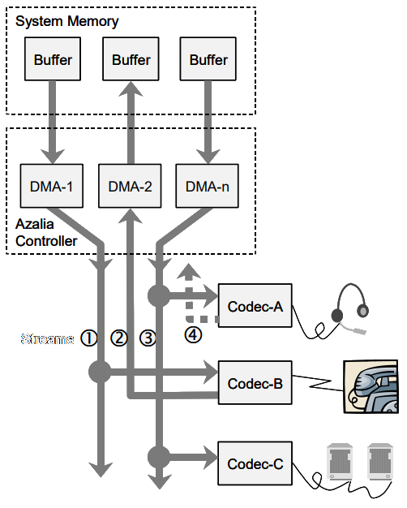
Getting Audio Flowing
Audio channels (e.g. left, right) are packed into streams between controller and a single codec in a single direction.
Each stream is driven by a DMA engine in the controller.
Courtesy of Intel High Definition Audio Specification

Slide 22
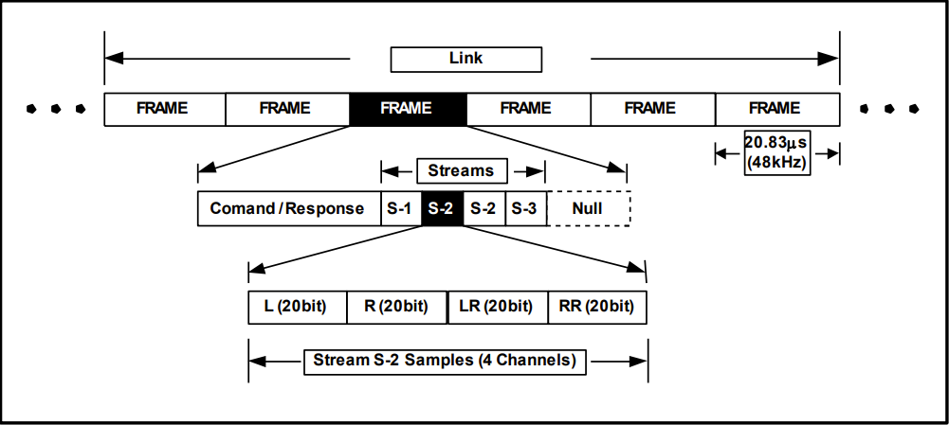
Getting Audio Flowing - Stream Contents
HD Audio Link traffic is packed into frames every 20.83 μs (48 kHz)
In this example there are three streams, and the S-2 stream has 4 channels (Left, Right, Left Rear, Right Rear).
Sample rates higher than the frame rate are supported; in this example two S-2 stream sample sets are included in the frame (2x48 kHz = 96 kHz).
Courtesy of Intel High Definition Audio Specification

Slide 23
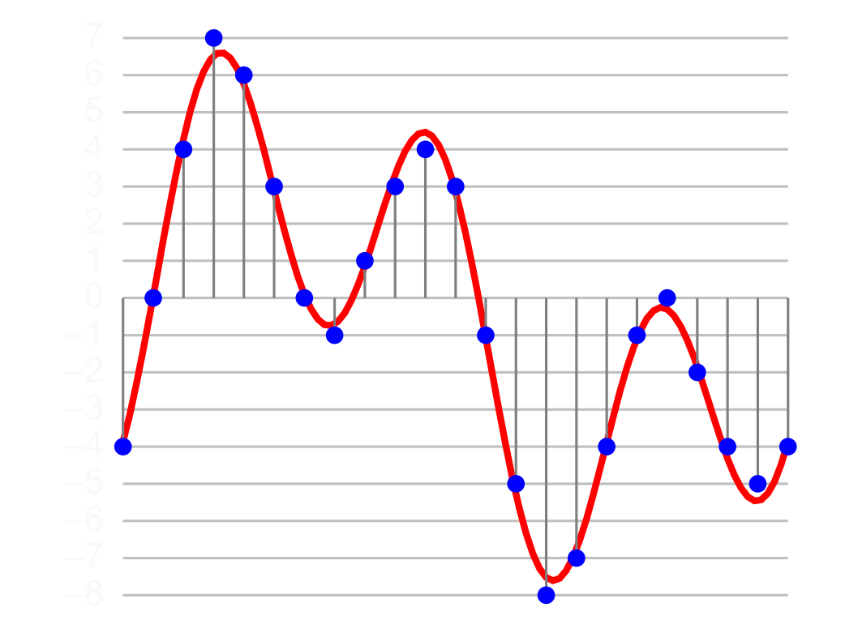
Getting Audio Flowing - Pulse Code Modulation (PCM)
Analog audio waveform represented as periodic digital samples.
Recall Nyquist’s theorem: max representable audio frequency is ½ sample rate.
Higher bit depths introduce less quantization noise.
Analog Signal (Red) Encoded in 4-bit PCM (Blue)
By Aquegg - Own work, CC BY-SA 3.0, https://commons.wikimedia.org/w/index.php?curid=29599378

Slide 24
Driver / Application Architecture
Kernel Driver
Detects and initializes single static HDA controller instance. (assumes only one controller, still allows multiple codecs / outputs)
Configures controller and codec to accept stream, sets up DMA engine to read audio samples.
Writes data to codecs over HD Audio link, updates DMA position buffer and buffer descriptor list with progress
User Program
Gets handle to HDA controller
Uses driver methods to detect codecs and capabilities on link
Chooses codec and supported sample rate / bit depth combination
Allocates memory region(s) for PCM samples, fills with some audio data
Calls driver method to setup stream with audio parameters and pointer to audio buffer
Reads DMA position buffer or buffer descriptor list, update samples

Slide 25

DMX512 Driver

Slide 26
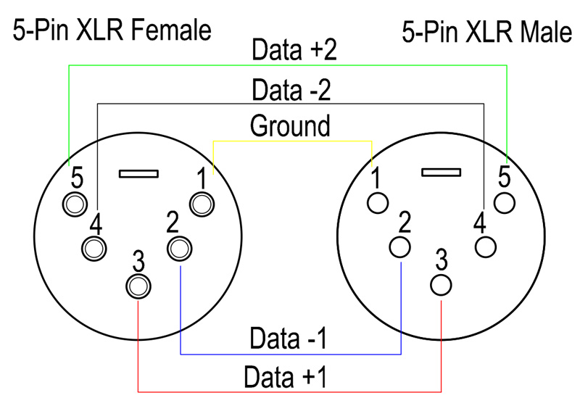
What is DMX512?
A standard protocol used to digitally control stage lighting and effects
Popularly used in the live event industry (theater, concerts) and for architectural lighting
DMX → Digital Multiplex
At the physical layer, it uses RS-485 and is wired with 3 conductors: data +/- and ground
Asynchronous, half-duplex with a bitrate of 250 kbps
RDM (Remote Device Management), is a newer addition to the DMX512 standard which allows for unidirectional communication

Slide 27
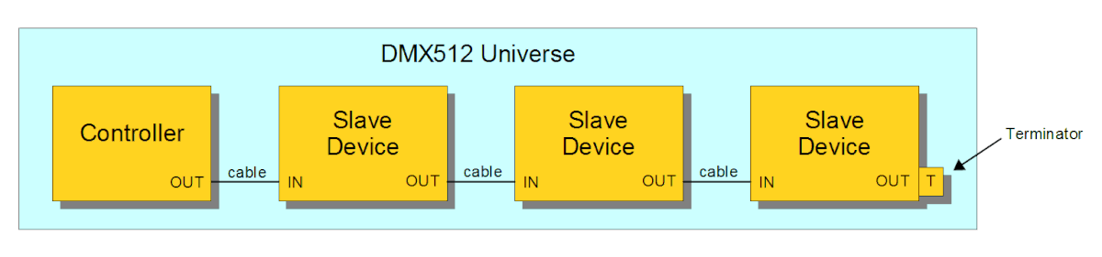
What is DMX512?
A DMX “universe” consists of 512 channels with each channel carrying a value between 0-255
Devices are daisy chained together in parallel
Depending on the mode of a connected device, it will choose which channels to look at and how to interpret it

Slide 28
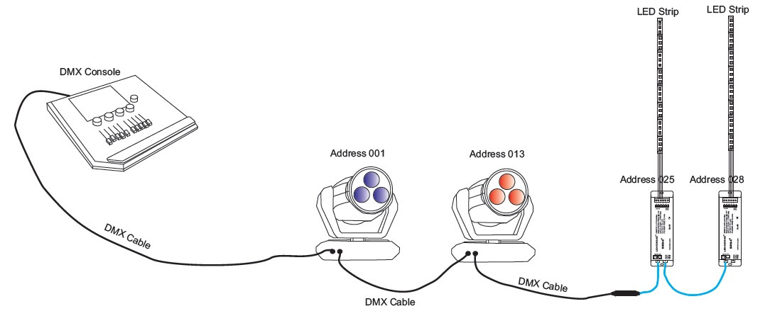
What is DMX512?

Slide 29
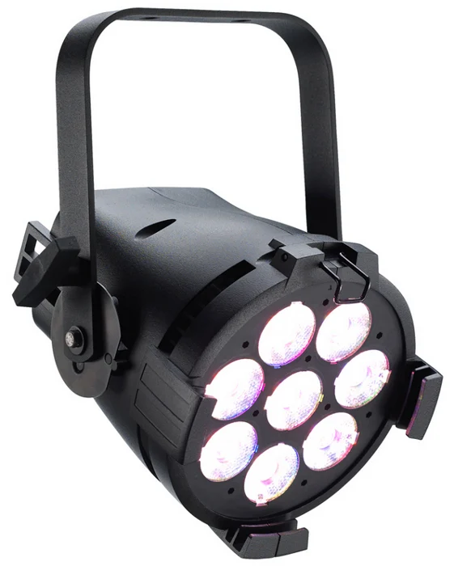
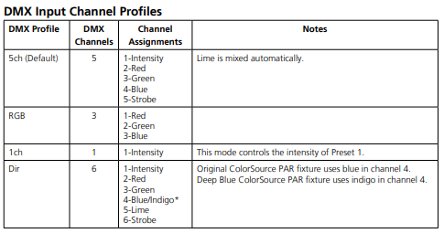
What is DMX512?

Slide 30
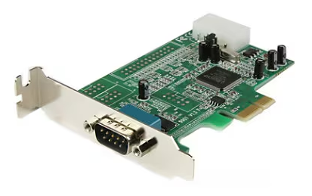
DMX512 Driver Support
Design Philosophies
Adherence to the DMX512 standard where possible
Assume compatibility with 16540/16550 UART chips
Baseline provides definitions for these chips already
Ensure basic DMX512 functionality before implementing additional features (RDM)
Implements the ANSI E1.11/USITT DMX512-A standard for transmitters
Easy to use in user programs

Slide 31
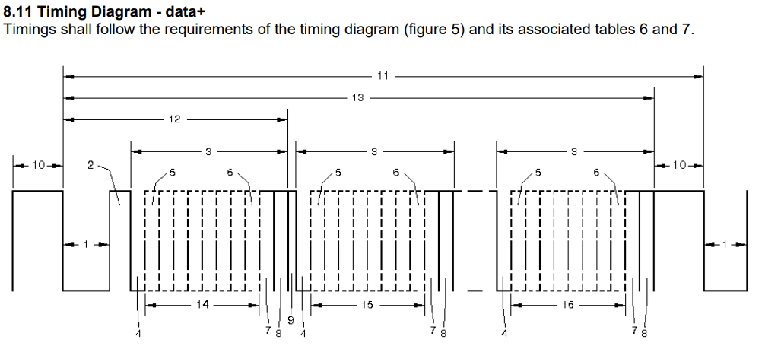
DMX512 Standard Details

Slide 32
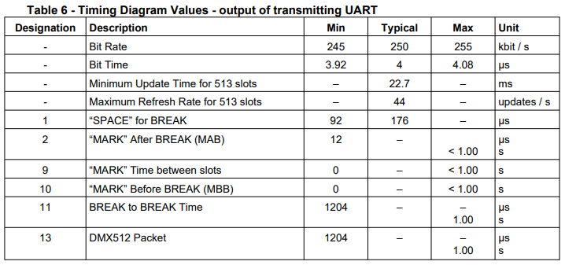
DMX512 Standard Details

Slide 33
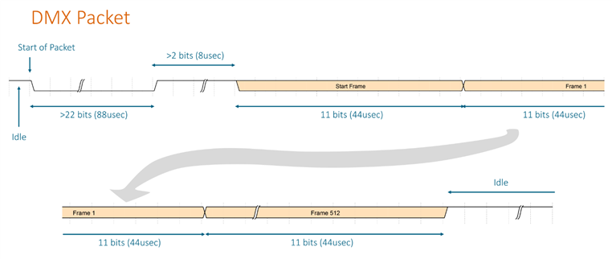
DMX512 Standard Details

Slide 34
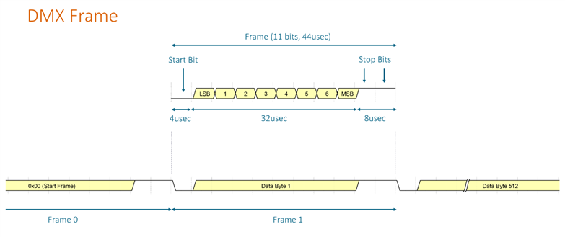
DMX512 Standard Details

Slide 35
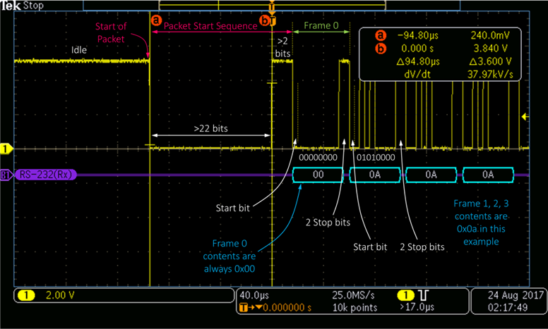
DMX512 Standard Details

Slide 36
Challenges
Baud Rate Mismatch
DMX512 calls for a baud rate of 250 kbps
16540/16550 UART chips can only handle up to 112.5 kbps (~ half)
Luckily, there’s enough tolerance in some parts of the spec where this can be cheesed
1 bit is roughly the same as 2 bits at 250 kbps
During testing, differences between the standard and real-world implementations
Not all fixtures support alternate start codes
The standard gives a lot of leeway in timing, varies from device to device in terms of what is actually accepted
“SPACE” for BREAK
They state 176 usec is typical, in practice it’s closer to ~94 usec
“MARK” After BREAK
Ranges from 12 usec to 1.00s, in practice it’s ~16-24 usec
“MARK” Time between slots
Ranges from 0 to 1.00s, in practice not used
In the case of lost or corrupt data, the standard suggests devices should retain the last valid state for at least 1 minute or state “data handling procedures” in the product manual
Not followed, most typically keep the state for 1-3 seconds

Slide 37
Thank You!

